Slide 1
Week 1
An Overview of Ethics

Slide 2

1-<number>
We Live in Communities
(London, England at night from space)
Courtesy of NASA
Society
- Association of people organized under a system of rules
- Rules: advance the good of members over time

Slide 3
1-<number>
The Ethical Point of View
Most people shares “core values”, desiring:
  Life
  Happiness
  Ability to accomplish goals
Two ways to view world
  Selfish point of view: consider only your own self and your core values
  Ethical point of view: respect other people and their core values

Slide 4
What is Ethics?
Set of rules/ code of behavior that is defined by the group to which an individual belongs
Establishes boundaries of generally accepted behavior conforms to generally accepted norms, which may change over time to meet the evolving needs of the society or a group of people (who share similar laws, traditions, and values that provide structure to enable them to live in an organized manner).
Help members of a group understand their roles and responsibilities so they can work together to achieve mutual benefits such as security, access to resources, and the pursuit of life goals.
  The ethics of the law profession
  The ethical standards of the medical profession

Slide 5
What are Morals?
The personal principles upon which an individual bases his or her decisions about what is right and what is wrong.
They are core beliefs formed and adhered to by an individual.
Your moral principles are statements of what you believe to be rules of right conduct.
Form basis for an established consensus
Software piracy —
Attitudes range from strong opposition to acceptance of the practice as a standard approach to conducting business.
The global rate of software piracy stands at around 42 percent

Slide 6
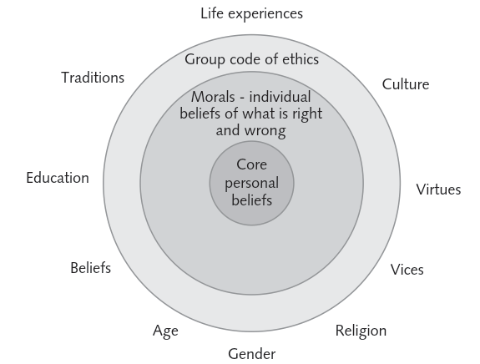
What is Ethics? (cont’d.)
Morality may vary by:
  Age
  Cultural group
  Ethnic background
  Religion
  Life experiences
  Education
  Gender

Slide 7
What are Laws?
Law is a system of rules that tells us what we can and cannot do.
Laws are enforced by a set of institutions (the police, courts, law-making bodies).
Violation of a law can result in censure, fines, and/or imprisonment.
Sometimes the laws of these various jurisdictions are in conflict, creating confusion and uncertainty. In addition, laws are not static; new laws are constantly being introduced and existing laws repealed or modified.
As a result, the precise meaning of a particular law may be different in the future from what it is today.

Slide 8
Other aspects of Ethics
Virtues
  Habits that incline people to do what is acceptable
Vices
  Habits of unacceptable behavior
Virtues and vices define a personal value system
  Scheme of moral values

Slide 9
The Difference Between Morals, Ethics & Laws
Morals: one’s personal beliefs about right and wrong
Ethics: standards or codes of behavior expected of an individual by a group
Law: system of rules that tells us what we can and cannot do
  Laws are enforced by a set of institutions
  Legal acts conform to the law
  Moral acts conform to what an individual believes is the right belief of right and wrong

Slide 10
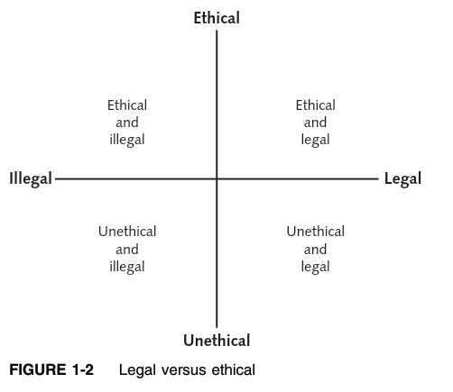
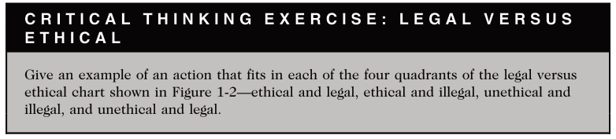

Slide 11
The Importance of Integrity
Integrity is a cornerstone of ethical behaviour
People with integrity:
  Act in accordance with a personal code of principles
  Extend to all the same respect and consideration
  Apply the same moral standards in all situations
Lack of integrity emerges if you apply moral standards differently according to situation or people involved
Many ethical dilemmas are not as simple as right versus wrong

Slide 12
Ethics in the Business World
Both the likelihood and the negative impact of inappropriate behavior have increased
Several trends have increased the likelihood of unethical behavior:
  Globalization creating complex work environments
  Organizations challenged to maintain profits / revenue
  Heightened vigilance by:
    Employees
    Shareholders
    Regulatory agencies

Slide 13
1-<number>
Why Study Ethics?
Ethics: a way to decide the best thing to do
New problems accompany new technologies
“Common wisdom” may not exist for novel situations brought about by new technologies

Slide 14
Ethics in the Business World (cont’d.)
Recent scandals in IT companies
  Google Lawsuit
  Ban on Tiktok
  Satyam Computers
  Axact Pvt Limited
Not just executives, but even lower-level employees, can find themselves in the middle of an ethical dilemma

Slide 15
Why Fostering Good Business Ethics is Important
To gain the good will of the community
To create an organization that operates consistently
To foster good business practices
To protect organization/employees from legal action
To avoid unfavorable publicity

Slide 16
Gaining the Good Will of the Community
Organizations have fundamental responsibilities to society
  Declared in formal statement of company’s principles or beliefs
  Include:
    Making contributions to charitable organizations and non-profit institutions
    Providing benefits for employees in excess of legal requirements
    Choosing economic opportunities that might be more socially desirable than profitable

Slide 17
Gaining the Good Will of the Community (cont’d.)
Socially responsible activities create good will
Good will makes it easier for corporations to conduct business

Slide 18
Creating an Organization That Operates Consistently
Ethics in Information Technology, Fourth Edition
Consistency ensures that employees:
  Know what is expected of them
  Can employ the organization’s values to help them in decision making
Consistency also means that shareholders, customers, suppliers, and community know what they can expect of the organization

Slide 19
Fostering Good Business Practices
Good ethics means good business/improved profits
Companies that:
  Produce safe and effective products
    Avoid costly recalls and lawsuits
  Provide excellent service that retains customers
  Develop and maintain strong employee relations
    Suffer lower turnover rates
    Enjoy better employee morale

Slide 20
Fostering Good Business Practices (cont’d.)
Suppliers/business partners place priority on working with companies that operate in a fair and ethical manner
Bad ethics means bad business/waning profits
  Bad ethics can lead to bad business results
  Bad ethics can have a negative impact on employees

Slide 21
Protecting the Organization and Its Employees from Legal Actions
U.S. Supreme Court established that an employer can be held responsible for the acts of its employees
This principle is called respondeat superior
Coalition of several legal organizations argues establishment of ethics and compliance programs should reduce criminal liability of organization
Others argue company officers should not be given light sentences if their ethics programs are ineffective

Slide 22
Avoiding Unfavorable Publicity
Public reputation of company strongly influences:
  Value of its stock
  How consumers regard products and services
  Degree of oversight received from government
  Amount of support and cooperation received
Organizations are motivated to build strong ethics programs to avoid negative publicity

Slide 23
Improving Corporate Ethics
Characteristics of a successful ethics program
  Employees willing to seek advice about ethical issues
  Employees feel prepared to handle situations that could lead to misconduct
  Employees are rewarded for ethical behavior
  Employees are not rewarded for success obtained through questionable means
  Employees feel positive about their company

Slide 24
Appointing a Corporate Ethics Officer
Corporate ethics officer
  Provides vision and leadership in business conduct
  Should be well-respected, senior-level manager who reports directly to the CEO
  Ensures ethical procedures are put in place
  Creates and maintains ethics culture
  Is responsible for key knowledge/contact person for ethical issues

Slide 25
Establishing a Corporate Code of Ethics (cont’d.)
  Cannot gain company-wide acceptance unless it is:
    Developed with employee participation
    Fully endorsed by organization’s leadership
  Must continually be applied to company’s decision making and emphasized as part of its culture
  Breaches in the code of ethics must be identified and dealt with appropriately

Slide 26
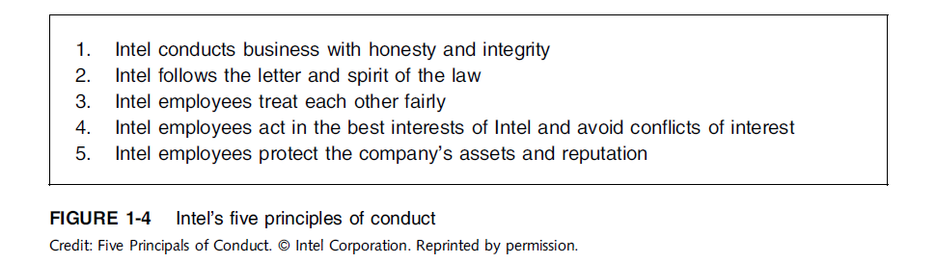
Establishing a Corporate Code of Ethics (cont’d.)

Slide 27
Conducting Social Audits
Social audit
  Reviews how well organization is meeting ethical and social responsibility goals
  Communicates new goals for upcoming year
  Shared broadly with employees, shareholders, investors, market analysts, customers, suppliers, government agencies, and local communities

Slide 28
Requiring Employees to Take Ethics Training
Personal convictions improved through education
Comprehensive ethics education program encourages employees to act responsibly and ethically
  Often presented in small workshop formats
  Employees apply code of ethics to hypothetical but realistic case studies
  Demonstration of recent company decisions based on principles from the code of ethics
Critical that training increase the percentage of employees who report incidents of misconduct
Employees must:
  Learn effective ways of reporting incidents
  Be reassured their feedback will be acted on without retaliation

Slide 29
Including Ethical Criteria in Employee Appraisals
Only 43% of companies include ethical conduct in employee’s performance appraisal
Ethical criteria include:
  Treating others fairly and with respect
  Operating effectively in a multicultural environment
  Accepting personal accountability
  Continually developing themselves and others
  Operating openly and honestly with all

Slide 30
Creating an Ethical Work Environment
Good employees may make bad ethical choices
May be encouraged to do “whatever it takes” to get the job done
Employees need a knowledgeable resource to discuss perceived unethical practices
  A manager
  Legal or Internal Audit Department
  Business Unit’s legal counsel
  Anonymously through internal Web site

Slide 31
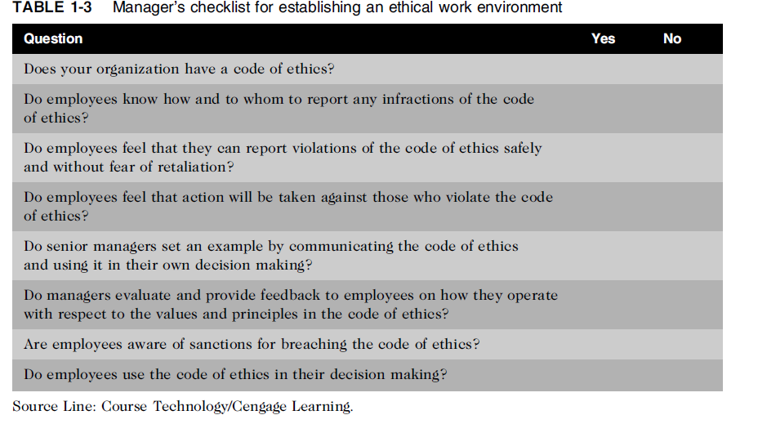
Creating an Ethical Work Environment (cont’d.)

Slide 32
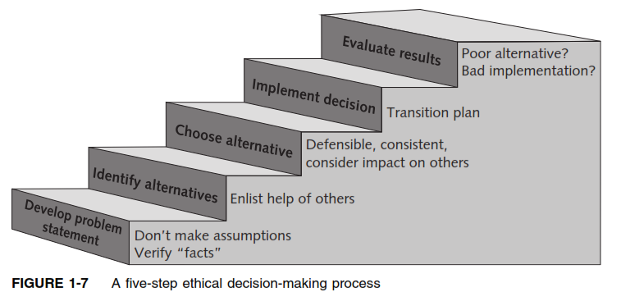
Including Ethical Considerations in Decision Making
Steps in a decision-making process
  Develop problem statement
  Identify alternatives
  Evaluate and choose alternative
  Implement decision
  Evaluate results
  Success

Slide 33
Develop a Problem Statement
Clear, concise description of the issue
Answers these questions:
  What causes people to think there is a problem?
  Who is directly affected by the problem?
  Is there anyone else affected?
  How often does it occur?
  What is the impact of the problem?
  How serious is the problem?
Most critical step in decision-making process

Slide 34
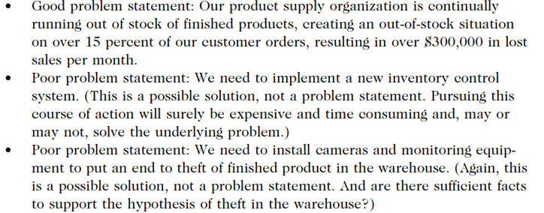
Develop a Problem Statement (cont’d.)
Example of a good problem statement:
  “Our product supply organization is continually running out of stock of finished products, creating an out-of-stock situation on over 15 percent of our customer orders, resulting in over $300,000 in lost sales per month.”
Examples of poor problem statements:
  “We need to implement a new inventory control system.” (possible solution, not a problem statement)
  “We have a problem with finished product inventory.” (not specific enough)

Slide 35
Identify, Evaluate, and Choose an Alternative
Enlist help to brainstorm alternative solutions
Evaluate by weighing laws, guidelines, and principles
Consider likely consequences of each alternative
Alternative selected must:
  Be ethically and legally defensible
  Be consistent with policies and code of ethics
  Take into account impact on others
  Provide a good solution to problem

Slide 36
Implement the Decision and
Evaluate the Results
Implement the decision
  Efficient, effective, timely implementation
  Communication is key for people to accept change
  Transition plan made easy and pain-free
Evaluate the results
  Monitor results for desired effect
  Observe impact on organization and stakeholders
  Return to “Develop problem statement” step if further refinements may be needed

Slide 37
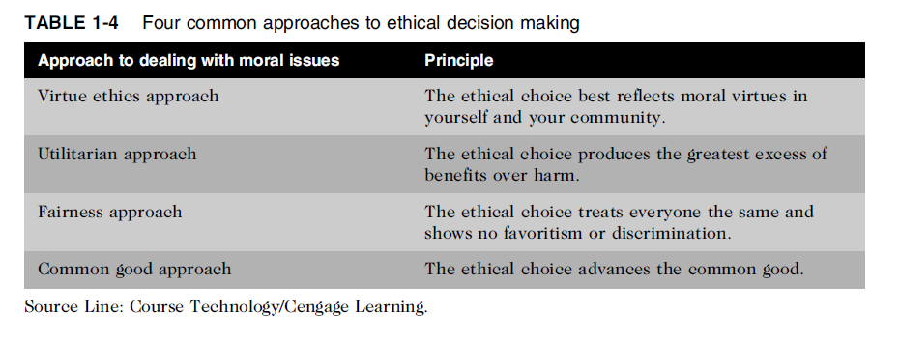
Common Approaches to Ethical Decision Making
Table 1-5 Four common approaches to ethical decision making

Slide 38
Virtue Ethics Approach
Virtue ethics approach
  Focuses on concern with daily life in a community
  People guided by virtues to reach “right” decision
  More effective than following set of principles/rules
Problems
  Does not provide guide for action
  Virtue cannot be worked out objectively; depends on circumstances

Slide 39
Utilitarian Approach
Utilitarian approach
  Chooses action that has best overall consequences
  Finds the greatest good by balancing all interests
  Fits concept of value in economics and the use of cost-benefit analysis
Problems
  Measuring and comparing values is often difficult
  Predicting resulting benefits and harm is difficult

Slide 40
Fairness Approach
Fairness approach
  Focuses on fair distribution of benefits/burdens
  Guiding principle is to treat all people the same
Problems
  Decisions can be influenced by personal bias
  Others may consider the decision unfair

Slide 41
Common Good Approach
Common good approach
  Work together for common set of values and goals
  Implement systems that benefit all people
Problems
  Consensus is difficult
  Some required to bear greater costs than others

Slide 42
Assignment Zero
Read “the little book of plagiarism” published by HEC.

